Slide 1

WEB SERVICES
Aruna S
Department of
Computer Science and Engineering

Slide 2

WEB SERVICES
SOAP
S. Aruna
Department of Computer Science and Engineering

Slide 3
WEB SERVICES
SOAP
SOAP is an XML-based protocol for accessing web services over HTTP.
SOAP is known as the Simple Object Access Protocol.
Developed as an intermediate language so that applications built on various programming languages could talk easily to each other.
Data Exchange between heterogeneous applications.
Use XML (Extensible Markup Language) as the intermediate language for exchanging data between application since XML is understood by all the programming language.
SOAP gives a standard specification to usage of XML.

Slide 4
WEB SERVICES
Advantages of SOAP
SOAP is the perfect medium which can be used for web services to talk with client applications.
SOAP is a light-weight protocol that is used for data interchange between applications.
SOAP is designed to be platform independent and is also designed to be operating system independent.
SOAP works on the HTTP protocol

Slide 5
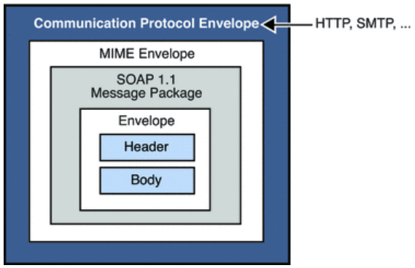
WEB SERVICES
SOAP Building Blocks
A "SOAP message“ is sent to the web service and the client application.
various building blocks of a SOAP Message are

Slide 6
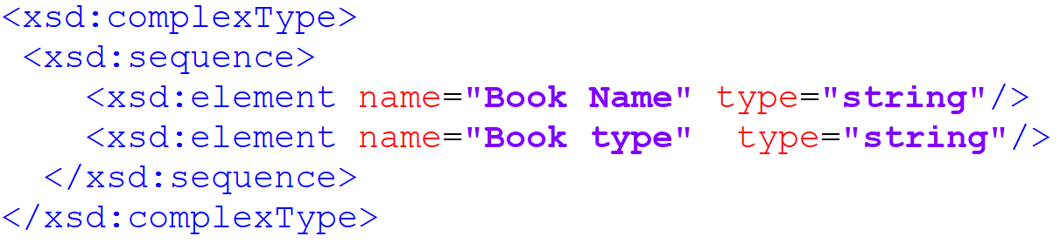
WEB SERVICES
SOAP Building Blocks
The SOAP message is nothing but a mere XML document which has the below components.
An Envelope element that identifies the XML document as a SOAP message .
A Header element that contains header information such as authentication credentials and definition of complex types

Slide 7
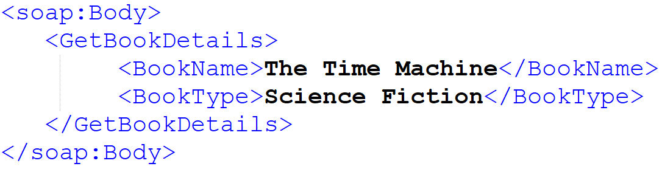
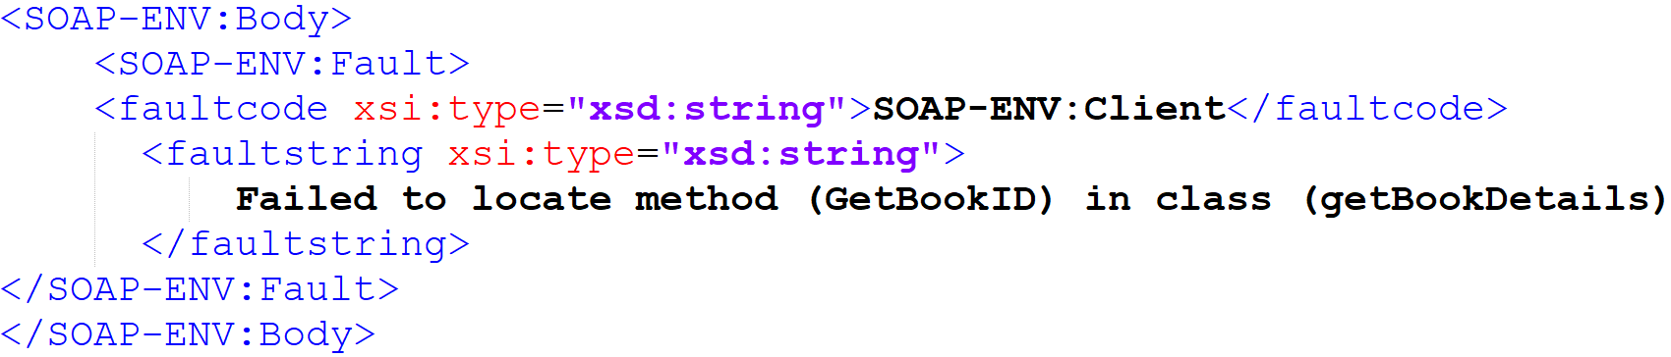
WEB SERVICES
SOAP Building Blocks
A Body element that contains call and response information
An optional fault element

Slide 8
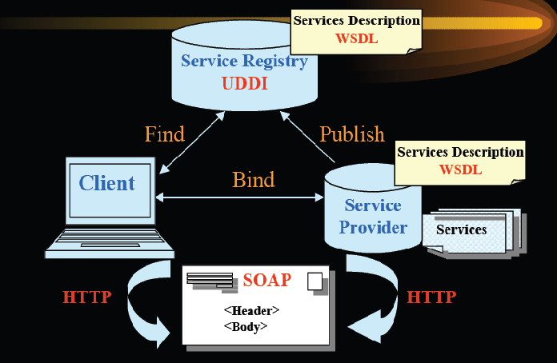
WEB SERVICES
SOAP Communication

Slide 9
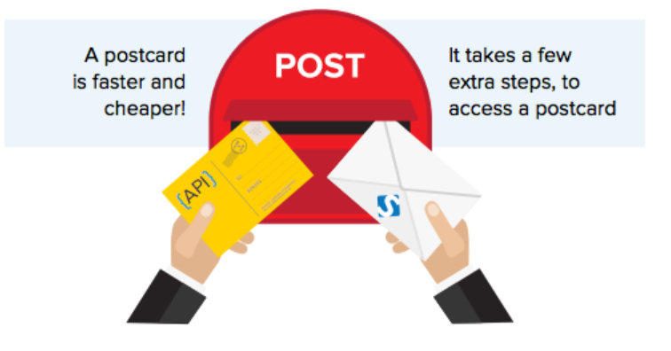
WEB SERVICES
SOAP vs REST

Slide 10
THANK YOU
Aruna S
Department of
Computer Science and Engineering
arunas@pes.edu

